Slide 1



Data Professional
View in Power BI
Last data refresh:
12/21/2024 12:04:01 AM UTC
Downloaded at:
12/21/2024 12:04:53 AM UTC

Slide 2
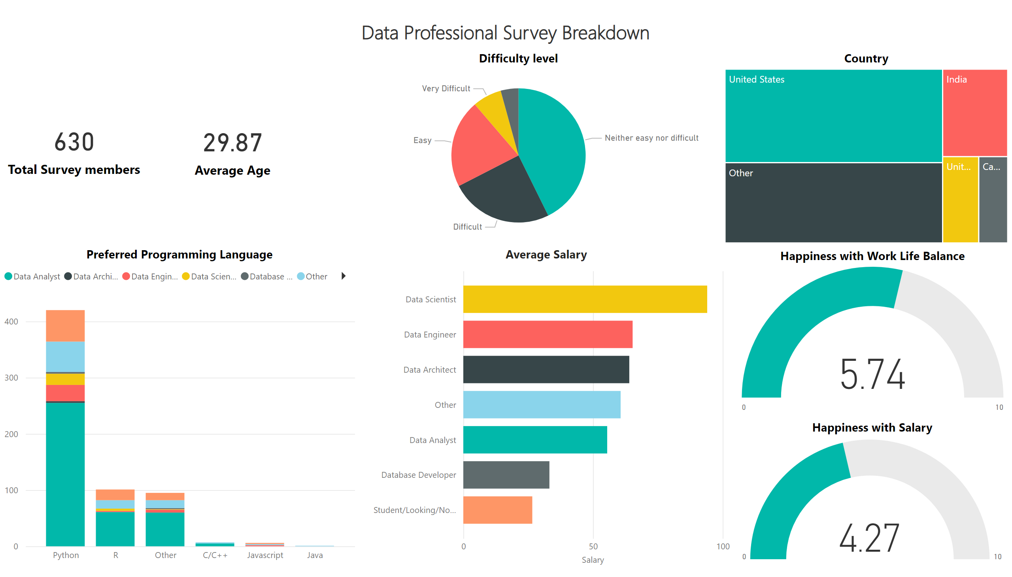
Page 1
Notes:
textbox
No alt text provided
Country
No alt text provided
Average Salary
No alt text provided
card
No alt text provided
card
No alt text provided
Preferred Programming Language
No alt text provided
Happiness with Salary
No alt text provided
Happiness with Work Life Balance
No alt text provided
Difficulty level
No alt text provided

